Slide 1
Synthesis
Protective
Face Masks
Data Scientist
Recruitment
Challenge

Slide 2
AGENDA
Data Introduction
Basic Data Visualization
Insights & Strategies
Text Analysis
Summary

Slide 3
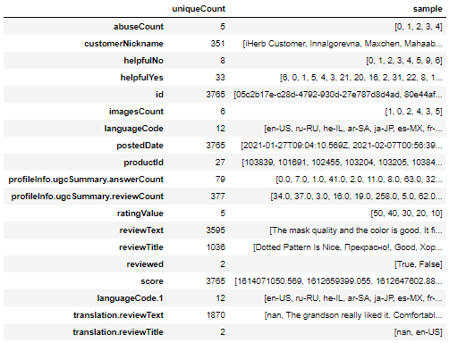
DATA INTRODUCTION
reviews.tsv

Slide 4
DATA INTRODUCTION
reviews.tsv

Slide 5
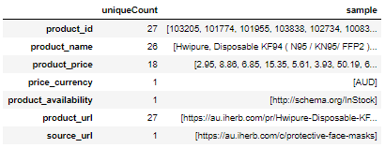
DATA INTRODUCTION
products.tsv

Slide 6
DATA INTRODUCTION
products.tsv

Slide 7
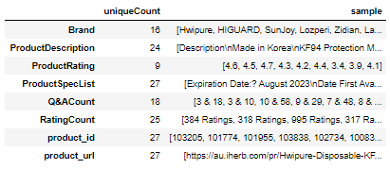
DATA INTRODUCTION
Products_extraInfo.csv

Slide 8
Basic Data Visualization

Slide 9
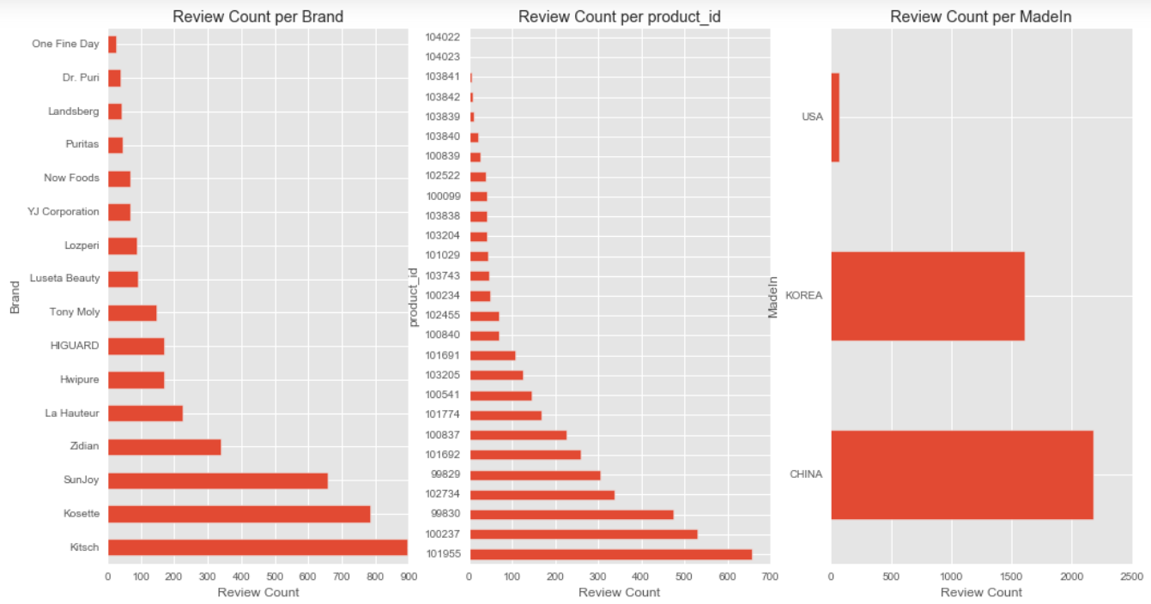
DATA VISUALIZATION

Slide 10
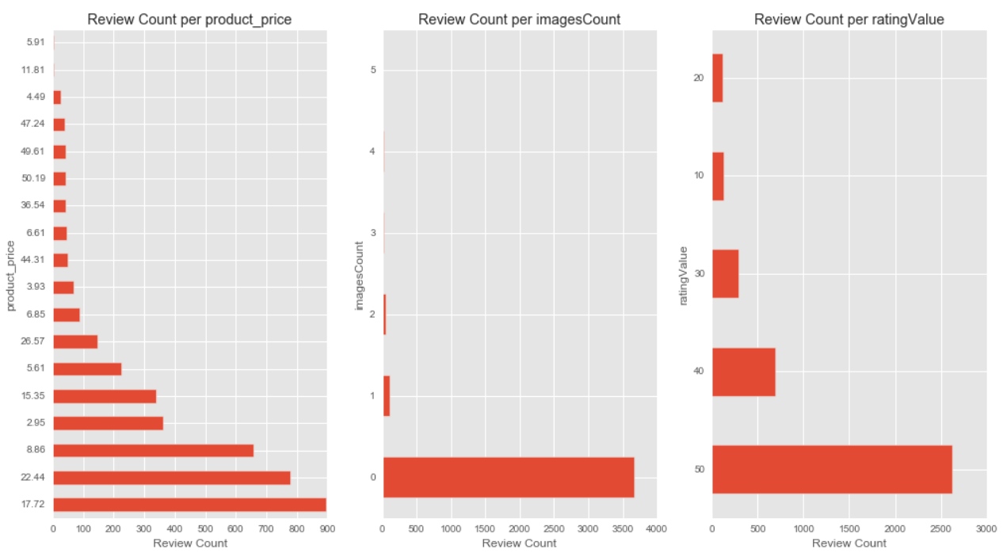
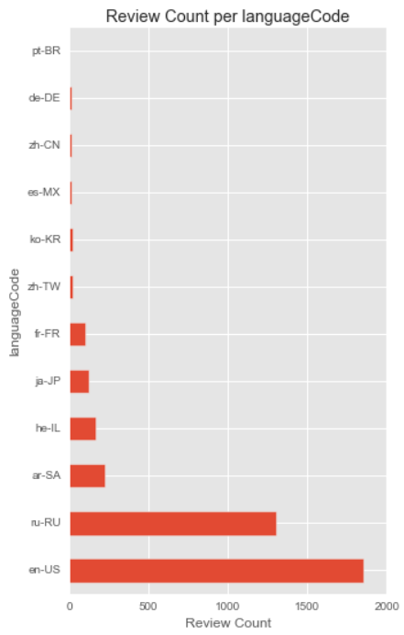
DATA VISUALIZATION

Slide 11
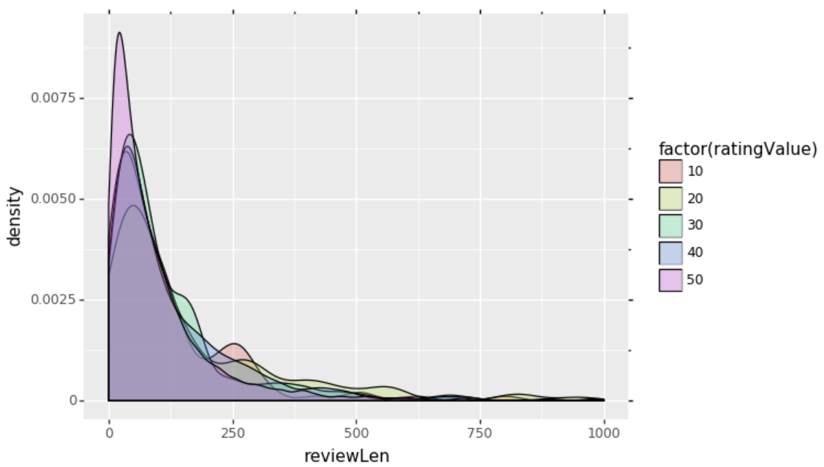
DATA VISUALIZATION
Notes:
Hebrew from Isarael?

Slide 12
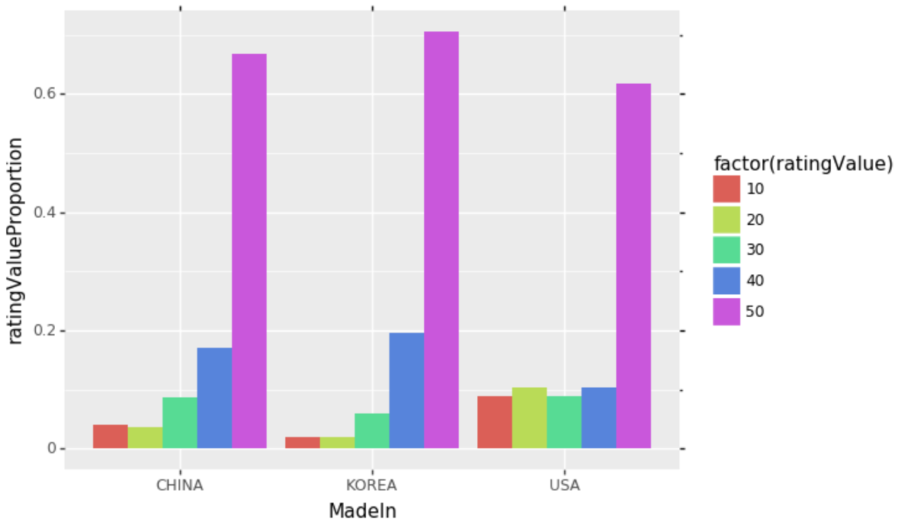
DATA VISUALIZATION
Notes:
Hebrew from Isarael?

Slide 13
Insights & Strategies

Slide 14
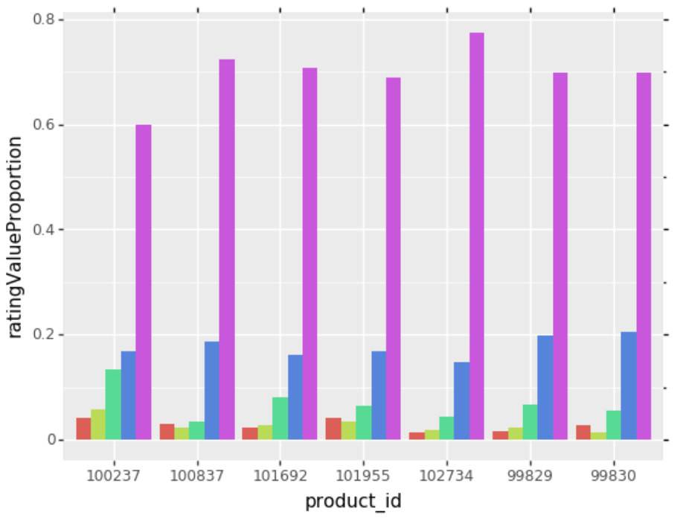
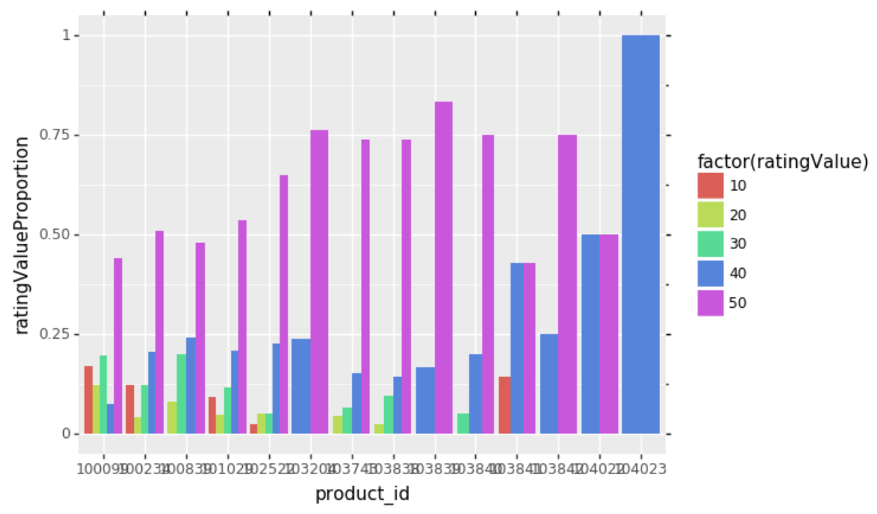
INSIGHTS & STRATEGIES
High Reviews
Low Reviews
Notes:
Hebrew from Isarael?

Slide 15
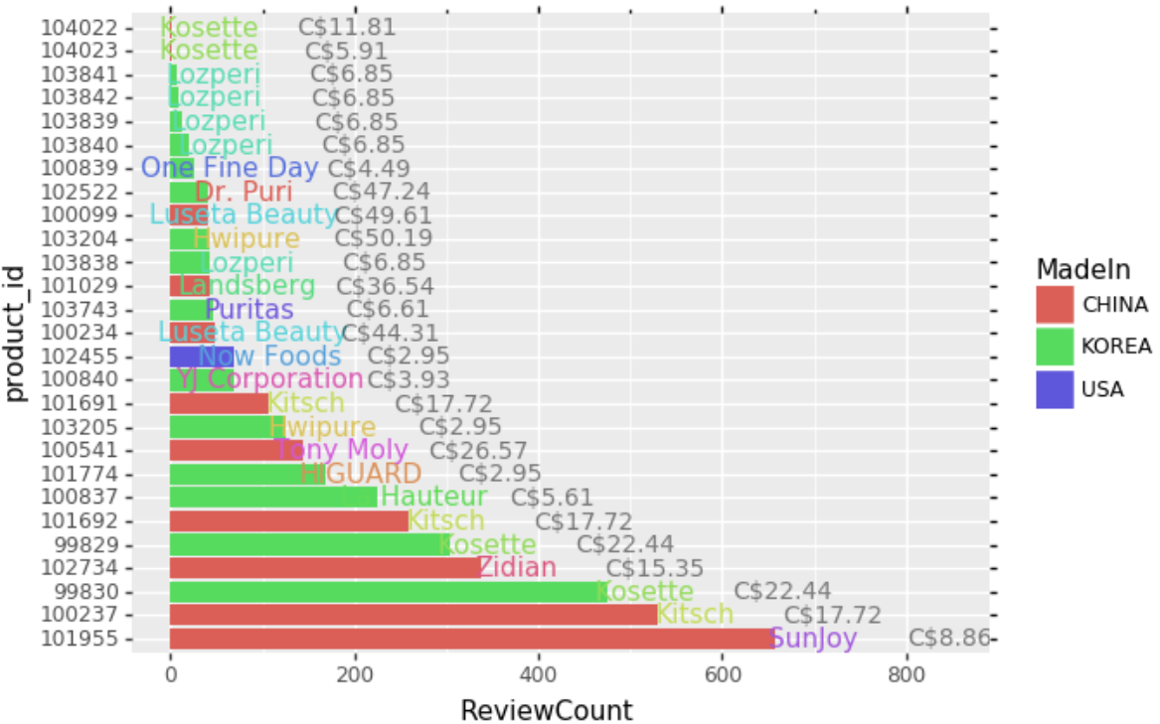
INSIGHTS & STRATEGIES

Slide 16
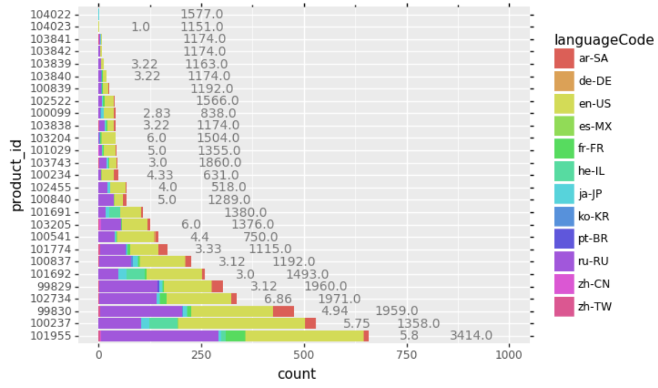
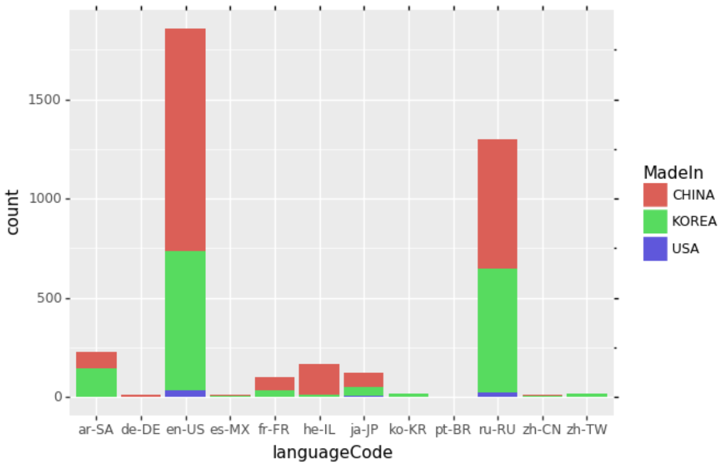
INSIGHTS & STRATEGIES
Product Desc
Length
Q&A Ratio
Notes:
Hebrew from Isarael?

Slide 17
Text Analysis

Slide 18
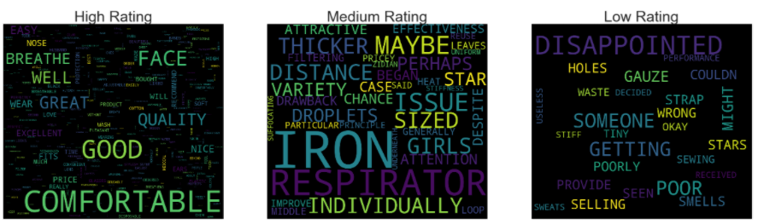
TEXT ANALYSIS

Slide 19
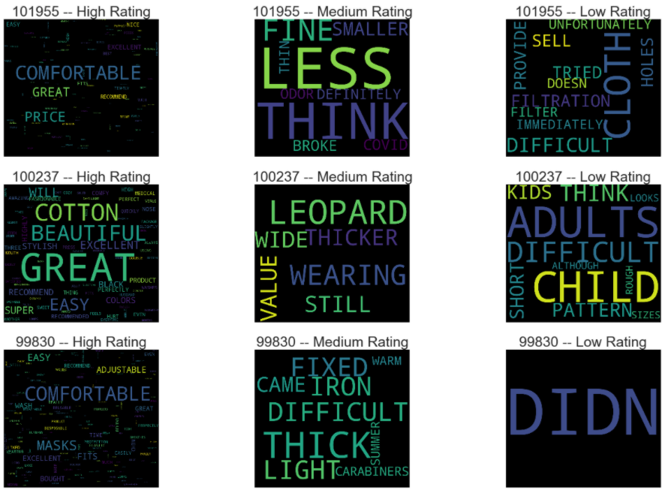
TEXT ANALYSIS

Slide 20
IT S <<DIFFICULT>> TO BREATHE
THE MASKS ARE TOO THICK IT IS <<DIFFICULT>> TO BREATHE IN THEM AND THE FEELING IS NOT VERY GOOD ALTHOUGH THEY LOOK VERY BEAUTIFUL
VERY TICK SO <<DIFFICULT>> TO BREATH THE BLACK ONE IS VERY SMALL SUITABLE FOR CHILDREN

Slide 21
I OPENED THE PACK TOOK OUT THE FIRST MASK THE ELASTIC <<IMMEDIATELY>> CAME OFF I HAD TO SEW THE SIZE IS SMALL IT DOES NOT FIT A LARGE FACE
THE FIRST MASK I TRIED ON HAD THE EAR STRAP <<IMMEDIATELY>> RIPPED OFF I HAVE MORE MASKS TO TRY AND SEE
THEY ARE OK BUT EVERY SECOND MASK I TRIED TO USE HAD A DEFECT MOSTLY THE STRINGS WOULD FALL OFF ALMOST <<IMMEDIATELY>> THE BATCH SEEMS TO BE FAULTY WHICH IS FRUSTRATING IN SUCH A PRODUCT ON WHICH YOUR HEALTH ACTUALLY DEPENDS I AT FIRST PURCHASED A PACK HERE WHICH WAS GREAT UNFORTUNATELY IT S NO LONGER AVAILABLE ON IHERB I HOPE THEY BRING IT BACK

Slide 22
I <<DIDN>> T LIKE THE MASK I CAN T BREATHE WELL MY EARS ARE VERY SORE
I <<DIDN>> T LIKE THE DESIGN OF THE MASK IT <<DIDN>> T FIT MY FACE NOT COMFORTABLE DOES NOT FIT SNUGLY AROUND THE ENTIRE PERIMETER AND I LOOK LIKE A DUCK IN IT LIES IDLE UNFORTUNATELY
COMPARED TO THE USUAL MEDICAL DISPOSABLE MASK THIS ONE IS VERY STUFFY I <<DIDN>> T LIKE IT

Slide 23
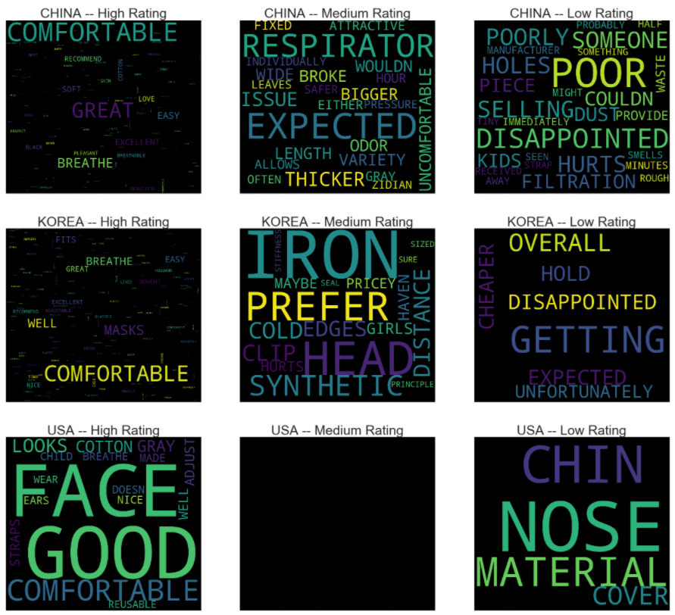
TEXT ANALYSIS

Slide 24
VERY BAD QUALITY OF MASKS UNCOMFORTABLE FIT <<POOR>> QUALITY OF EAR STRAPS
THE ONE I RECEIVED WAS <<POOR>>LY MADE IT HAD SOME LOOSE STRINGS THE MATERIAL USED IS NOT VERY BREATHABLE IN HOT HUMID CLIMATE CUTE COLOURS AND PATTERNS THO I VE NOT SEEN THEM ANYWHERE ELSE
THE PRODUCT IS CUT OFF WHEN WEARING <<POOR>> QUALITY

Slide 25
GREAT SO IHERB BROUGHT THESE IN SO WE HAVE ACCESS TO HIGH FILTERING MASKS ONLY THING IS I HAVE TO TIE THE ENDS BECAUSE THE STRAPS A BIT LONG IF YOU HAVE A SMALLER <<HEAD>>
YOU GENERALLY NEED A LARGER <<HEAD>> FOR IT TO NOT AIR GAP
SITS TIGHT IT IS COMFORTABLE TO BREATHE IN IT IT FIXES WELL ON THE <<HEAD>> BUT BECAUSE OF THE ADJUSTING CARABINERS IT HURTS THE EARS

Slide 26
DARK GRAY COMFORTABLE MASK THE LOGO LOOKS VERY GOOD SUITABLE FOR A SMALLER <<FACE>>
THE MASK FITS WELL ON THE <<FACE>> IT S SMALL FOR AN ADULT AND DOESN T PREFER IT BUT THAT S EXACTLY WHAT I LIKE BECAUSE IT DOESN T INTERFERE WITH BREATHING
THE BEST MASK FOR A SMALL <<FACE>> GRAY BREATHES WELL

Slide 27
THE MASK IS A LITTLE TOO SMALL OR I HAVE AN OVERSIZED HEAD LOL IT ALSO DOESN T COVER THE FACE FROM <<NOSE>> TO CHIN OR IT S MY OVERSIZED HEAD AGAIN BUT IT IS A SHIPPING SAVER
THE MASK IS NOT TOO SMALL FOR MY FACE BUT THERE IS ONLY ONE FOLD IN THE MATERIAL FOR EXPANDING THE MASK AROUND THE <<NOSE>> AND CHIN SO IT DOES NOT ACTUALLY COVER ENOUGH TO USE IT AND BE PROTECTED IF THEY HAD ADDED JUST ONE MORE FOLD IN THE MATERIAL TO ALLOW FOR THE <<NOSE>> AND CHIN IT WOULD BE PERFECT FOR SMALL MEDIUM ADULT FACES THIS COULD BE FOR CHILDREN IF YOU ADD YOUR OWN <<NOSE>> WIRE TO HELP THE MASK SHAPE THE TOP OF THE MASK

Slide 28
Strategic Pricing according to production source
Be engaging in answering customers’ questions
Full detailed product description
Comfort of the product is most mentioned
Quality of mask (especially the straps)
Cater to different demographic
Child, Bigger face, allow Makeup

Slide 29
Synthesis
Protective
Face Masks
Data Scientist
Recruitment
Challenge

